Slide 1
Predicting Risk of Heart Disease with Machine Learning
Mike Anderson, Mark Athanason, Thomas Stokes

Slide 2
Heart Disease
Blood Vessel Diseases (coronary artery disease)
Atypical heart rhythms (arrythmias, tachy/bradycardia, etc.)
Congenital defects
Cardiovascular Disease
Narrowed or blocked arteries
Atherosclerosis
Angina (chest pain)
Cardiac arrest or stroke

Slide 3
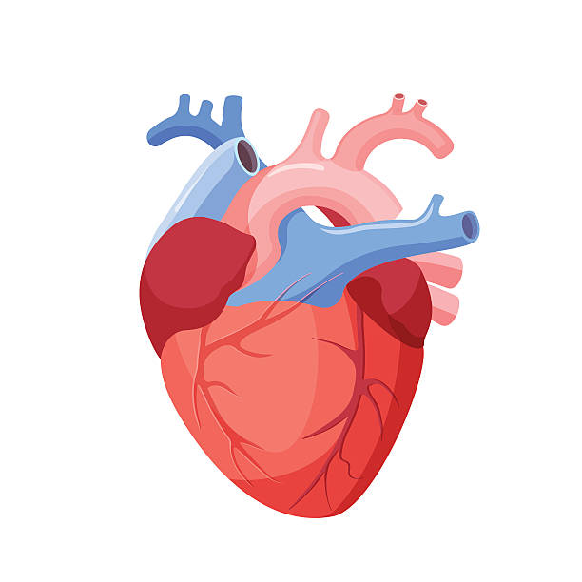
Measured Attributes
Stress Test Measurements (EKG)
Depression
Slope at Peak Exercise
Features
Age
Sex
Metabolic Parameters
Resting Blood Pressure
Fasting Blood Glucose
Serum Cholesterol
Imaging
Thalium Stress Test
Vessels Colored by Fluoroscopy
Cardiovascular Measurements
Resting Electrocardiographic Results
Maximum Heart Rate
Exercise Induced Angina
Diagnosis by Angiogram

Slide 4
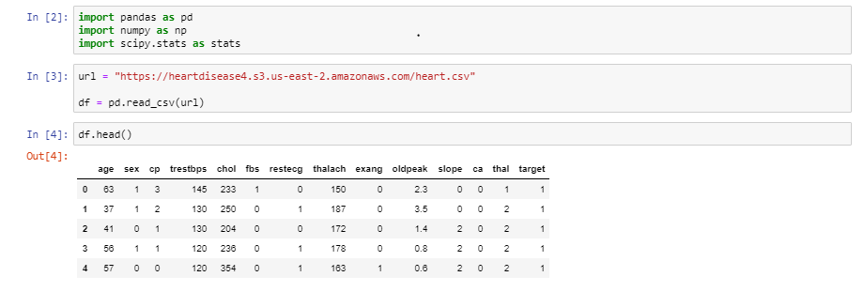
Viewing The Data

Slide 5
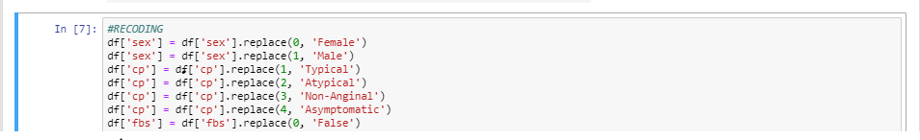
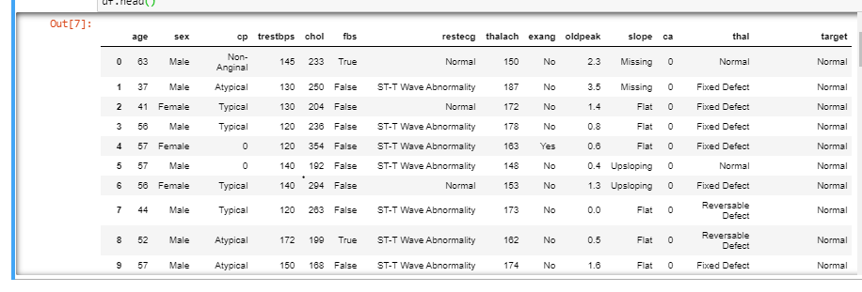
Translating The Data

Slide 6
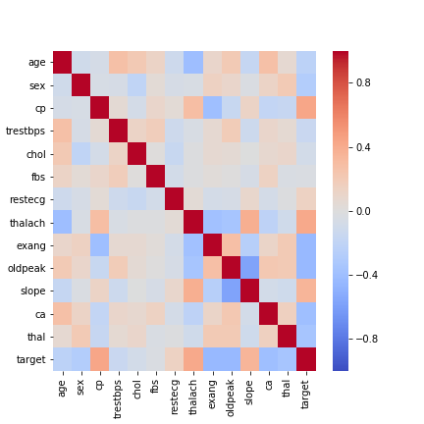
Best Features for Prediction

Slide 7
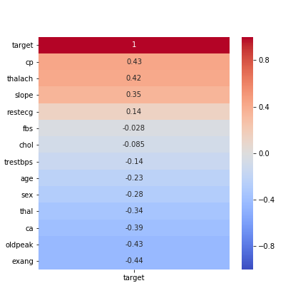
Best Features for Prediction

Slide 8
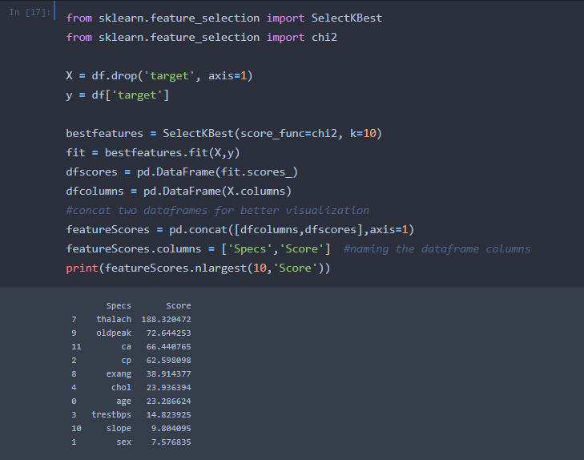
Best Features for Prediction

Slide 9
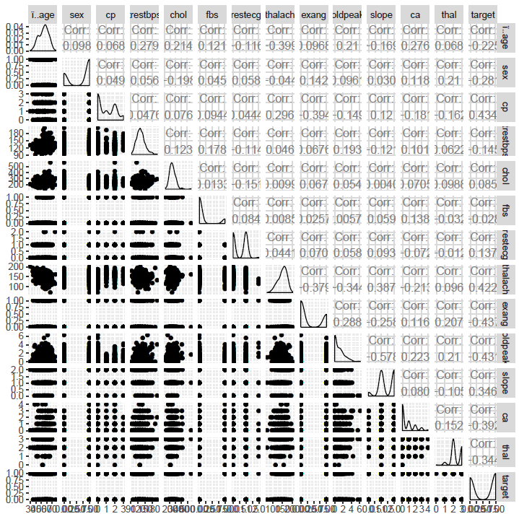
Best Features for Prediction

Slide 10
Machine Learning Scaling
MinMaxScaler
Used for all numerical variables
Scaled to themselves independently of each other
Scalers were saved for use in the program
OneHot Encoding (get_dummies)
Used for all categorical variables
Labels were previously LabelEncoded (0, 1, 2, etc.)
Encoding was replicated in the ML program

Slide 11
Machine Learning Models
K Nearest Neighbors
Best fit: k=11
Training Accuracy: 0.846
Testing Accuracy: 0.882
Random Forest Classifier
Used GridSearchCV to find the best parameters
Training Accuracy: 0.903
Testing Accuracy: 0.855
Neural Network
Sequential Classifier
Loss: 0.0643
Mean Absolute Error: 0.1296
Accuracy: 0.9383

